Slide 1

Context-Free Grammars
Chapter 11

Slide 2
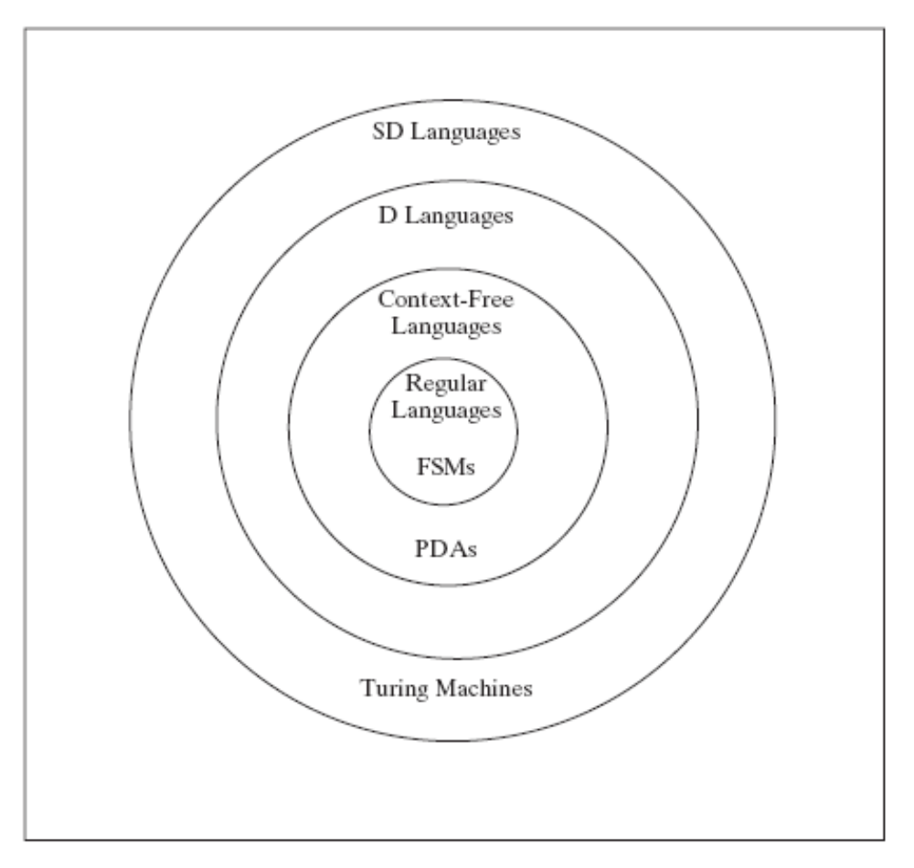
Languages and Machines

Slide 3
Context-free Grammars, Languages, and PDAs
Context-free Language
L
Context-free Grammar
Accepts
PDA

Slide 4
Context-Free Grammars
A context-free grammar G is a quadruple,
(V, Σ, R, S), where:
V is the rule alphabet
  Σ, a subset of V, the set of terminals
  V - Σ, the set of nonterminals
R, a finite subset of (V - Σ) ×V*, the set of rules
S, an element of V - Σ, the start symbol
Example:
({S, a, b}, {a, b}, {S → a S b, S → ε}, S)

Slide 5
Derivations
x ⇒_{G} y iff x = α A β
and A → γ is in R
y = α γ β
w₀ ⇒_{G} w₁ ⇒_{G} w₂ ⇒_{G} . . . ⇒_{G} w_{n} is a derivation in G.
Let ⇒_{G}* be the reflexive, transitive closure of ⇒_{G}.
Then the language generated by G, denoted L(G), is:
L(G) = {w ∈ Σ* : S ⇒_{G}* w}.

Slide 6
An Example Derivation
Example:
Let G = ({S, a, b}, {a, b}, {S → a S b, S → ε}, S)
S ⇒ a S b ⇒ aa S bb ⇒ aaa S bbb ⇒ aaabbb
S ⇒* aaabbb

Slide 7
Definition of a Context-Free Grammar
A language L is context-free iff it is generated by some
context-free grammar G.

Slide 8
A^{n}B^{n}
S → ε
S → aSb

Slide 9
Balanced Parentheses
S → ε
S → SS
S → (S)

Slide 10
Recursive Grammar Rules
A rule is recursive iff it is X → w₁Yw₂, where:
Y ⇒* w₃Xw₄ for some w₁, w₂, w₃, and w₄ in V*.
A grammar is recursive iff it contains at least one recursive rule.
Examples: S → (S) S → (T)
T → (S)

Slide 11
Self-Embedding Grammar Rules
A rule in a grammar G is self-embedding iff it is :
X → w₁Yw₂, where Y ⇒* w₃Xw₄ and
both w₁w₃ and w₄w₂ are in Σ⁺.
A grammar is self-embedding iff it contains at least one self-embedding rule.
Example: S → aSa is self-embedding
S → aS is recursive but not self-
embedding
S → aT
T → Sa is self-embedding

Slide 12
Where Context-Free Grammars Get Their Power
If a grammar G is not self-embedding then L(G) is regular.
If a language L has the property that every grammar that defines it is self-embedding, then L is not regular.

Slide 13
PalEven = {ww^{R} : w ∈ {a, b}*}
G = {{S, a, b}, {a, b}, R, S}, where:
R = { S → aSa
S → bSb
S → ε }.

Slide 14
Equal Numbers of a’s and b’s
Let L = {w ∈ {a, b}*: #_{a}(w) = #_{b}(w)}.
G = {{S, a, b}, {a, b}, R, S}, where:
R = { S → aSb
S → bSa
S → SS
S → ε }.

Slide 15
Arithmetic Expressions
G = (V, Σ, R, E), where
V = {+, *, (, ), id, E},
Σ = {+, *, (, ), id},
R = {
E → E + E
E → E ∗ E
E → (E)
E → id }

Slide 16
BNF
A notation for writing practical context-free grammars
The symbol | should be read as “or”.
Example: S → aSb | bSa | SS | ε
Allow a nonterminal symbol to be any sequence of characters surrounded by angle brackets.
Examples of nonterminals:
<program>
<variable>

Slide 17
BNF for a Java Fragment
<block> ::= {<stmt-list>} | {}
<stmt-list> ::= <stmt> | <stmt-list> <stmt>
<stmt> ::= <block> | while (<cond>) <stmt> |
if (<cond>) <stmt> |
do <stmt> while (<cond>); |
<assignment-stmt>; |
return | return <expression> |
<method-invocation>;

Slide 18
HTML
<ul>
<li>Item 1, which will include a sublist</li>
<ul>
<li>First item in sublist</li>
<li>Second item in sublist</li>
</ul>
<li>Item 2</li>
</ul>
A grammar:
HTMLtext → Element HTMLtext | ε
Element → UL | LI | … (and other kinds of elements that
are allowed in the body of an HTML document)
UL → <ul> HTMLtext </ul>
LI → <li> HTMLtext </li>

Slide 19
English
S → NP VP
NP → the Nominal | a Nominal | Nominal |
ProperNoun | NP PP
Nominal → N | Adjs N
N → cat | dogs | bear | girl | chocolate | rifle
ProperNoun → Chris | Fluffy
Adjs → Adj Adjs | Adj
Adj → young | older | smart
VP → V | V NP | VP PP
V → like | likes | thinks | shots | smells
PP → Prep NP
Prep → with

Slide 20
Designing Context-Free Grammars
● Generate related regions together.
A^{n}B^{n}
● Generate concatenated regions:
A → BC
● Generate outside in:
A → aAb

Slide 21
Concatenating Independent Languages
Let L = {a^{n}b^{n}c^{m} : n, m ≥ 0}.
The c^{m} portion of any string in L is completely independent of the a^{n}b^{n} portion, so we should generate the two portions separately and concatenate them together.
G = ({S, N, C, a, b, c}, {a, b, c}, R, S} where:
R = { S → NC
N → aNb
N → ε
C → cC
C → ε }.

Slide 22

L = { : k ≥ 0 and ∀i (n_{i} ≥ 0)}
Examples of strings in L: ε, abab, aabbaaabbbabab
Note that L = {a^{n}b^{n} : n ≥ 0}*.
G = ({S, M, a, b}, {a, b}, R, S} where:
R = { S → MS
S → ε
M → aMb
M → ε}.

Slide 23
Unequal a’s and b’s
L = {a^{n}b^{m} : n ≠ m}
G = (V, Σ, R, S), where
V = {a, b, S, A, B},
Σ = {a, b},
R =
S → A /* more a’s than b’s
S → B /* more b’s than a’s
A → a /* at least one extra a generated
A → aA
A → aAb
B → b /* at least one extra b generated
B → Bb
B → aBb

Slide 24
Structure
Context free languages:
We care about structure.
E
E + E
id E * E
3 id id
5 7

Slide 25
Derivations
To capture structure, we must capture the path we took through the grammar. Derivations do that.
Example:
S → ε
S → SS
S → (S)
1 2 3 4 5 6
S ⇒ SS ⇒ (S)S ⇒ ((S))S ⇒ (())S ⇒ (())(S) ⇒ (())()
S ⇒ SS ⇒ (S)S ⇒ ((S))S ⇒ ((S))(S) ⇒ (())(S) ⇒ (())()
1 2 3 5 4 6
But the order of rule application doesn’t matter.

Slide 26
Derivations
Parse trees capture essential structure:
1 2 3 4 5 6
S ⇒ SS ⇒ (S)S ⇒ ((S))S ⇒ (())S ⇒ (())(S) ⇒ (())()
S ⇒ SS ⇒ (S)S ⇒ ((S))S ⇒ ((S))(S) ⇒ (())(S) ⇒ (())()
1 2 3 5 4 6
S
S S
( S ) ( S )
( S ) ε
ε

Slide 27
Parse Trees
A parse tree, derived by a grammar G = (V, Σ, R, S), is a rooted, ordered tree in which:
● Every leaf node is labeled with an element of Σ ∪ {ε},
● The root node is labeled S,
● Every other node is labeled with some element of:
V – Σ, and
● If m is a nonleaf node labeled X and the children of m
are labeled x₁, x₂, …, x_{n}, then R contains the rule
X → x₁, x₂, …, x_{n}.

Slide 28
Ambiguity
A grammar is ambiguous iff there is at least one string in L(G) for which G produces more than one parse tree.
For most applications of context-free grammars, this is a problem.

Slide 29
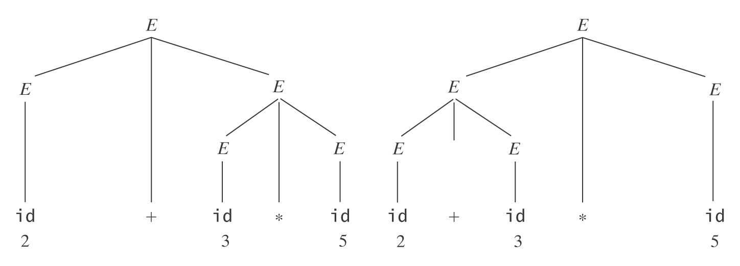
An Arithmetic Expression Grammar
E → E + E id + id * id
E → E ∗ E
E → (E)
E → id

Slide 30
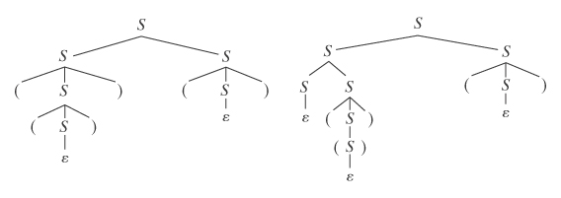
Even a Very Simple Grammar Can be Highly Ambiguous
S→ ε (())()
S → SS
S → (S)

Slide 31
Inherent Ambiguity
Some languages have the property that every grammar for them is ambiguous. We call such languages inherently ambiguous.
Example:
L = {a^{n}b^{n}c^{m}: n, m ≥ 0} ∪ {a^{n}b^{m}c^{m}: n, m ≥ 0}.
It can be proved that L is inherently ambiguous.
We can generate a^{n}b^{n}c^{m} and a^{n}b^{m}c^{m} unambiguously but a^{n}b^{n}c^{n} will be generated in two ways.

Slide 32
Inherent Ambiguity
Both of the following problems are undecidable:
Given a context-free grammar G, is G ambiguous?
Given a context-free language L, is L inherently
ambiguous?

Slide 33
But We Can Often Reduce Ambiguity
We can get rid of:
● ε rules like S → ε,
● rules with symmetric right-hand sides, e.g.,
S → SS
E → E + E
● rule sets that lead to ambiguous attachment of
optional postfixes.

Slide 34
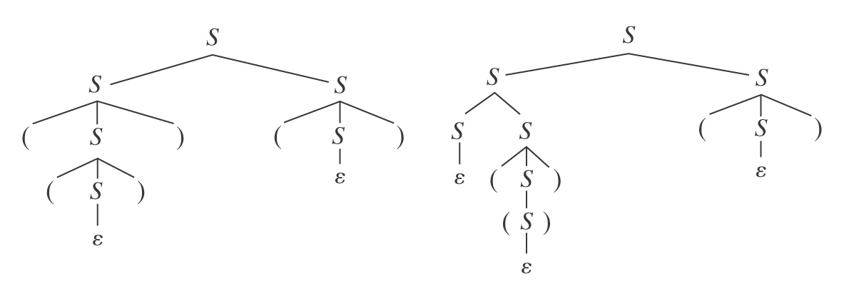
A Highly Ambiguous Grammar
S→ ε
S → SS
S → (S)

Slide 35
Resolving the Ambiguity with a Different Grammar
The biggest problem is the ε rule.
A different grammar for the language of balanced parentheses:
S* → ε
S* → S
S → SS
S → (S)
S → ()

Slide 36
Nullable Variables
A variable X is nullable iff either:
(1) there is a rule X → ε, or
(2) there is a rule X → PQR… and P, Q, R, …
are all nullable.
So compute N, the set of nullable variables, as follows:
1. Set N to the set of variables that satisfy (1).
2. Repeat until no change
Add variables satisfying (2)

Slide 37
A General Technique for Getting Rid of ε-Rules
Definition: a rule is modifiable iff it is of the form:
P → αRβ, for some nullable R, P ≠ αβ ≠ ε
removeEps(G: cfg) =
1. Let G′ = G.
2. Find the set N of nullable variables in G′.
3. For each modifiable rule P → αRβ of G do
Add the rule P → αβ.
4. Delete from G′ all rules of the form X → ε.
5. Return G′.
L(G′) = L(G) – {ε}

Slide 38
An Example
G = {{S, T, A, B, C, a, b, c}, {a, b, c}, R, S), R =
{ S → aTa
T → ABC
A → aA | C
B → Bb | C
C → c | ε }
Nullable varibles = {A, B, C, T}
G′: add : remove:
S → aa T → AC C → ε
T → A T → BC
T → B B → b
T → C A → a
T → AB

Slide 39
What If ε ∈ L?
atmostoneEps(G: cfg) =
1. G′′ = removeEps(G).
2. If S_{G} is nullable then /* i. e., ε ∈ L(G)
  2.1 Create in G′′ a new start symbol S*.
  2.2 Add to R_{G′′} the two rules:
S* → ε
S* → S_{G}.
3. Return G′′.

Slide 40
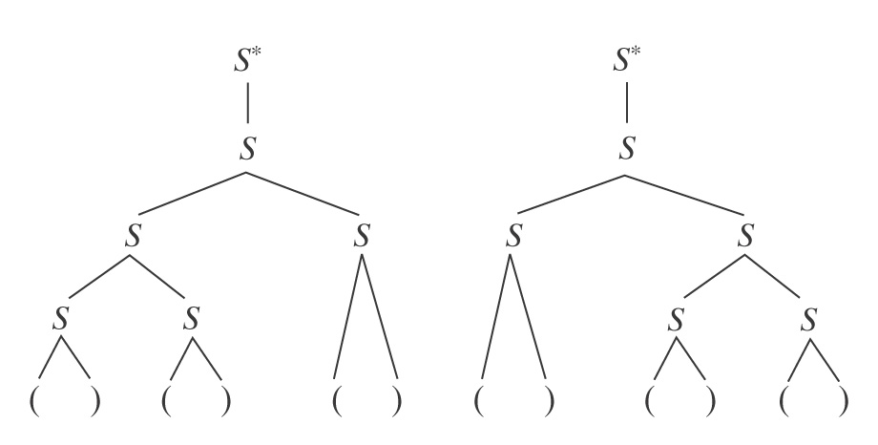
But There is Still Ambiguity
S* → ε What about ()()() ?
S* → S
S → SS
S → (S)
S → ()

Slide 41
Eliminating Symmetric Recursive Rules
S* → ε
S* → S
S → SS
S → (S)
S → ()
Replace S → SS with one of:
S → SS₁ /* force branching to the left
S → S₁S /* force branching to the right
So we get:
S* → ε S → SS₁
S* → S S → S₁
S₁ → (S)
S₁ → ()

Slide 42
Eliminating Symmetric Recursive Rules
So we get:
S* → ε
S* → S
S → SS₁
S → S₁
S₁ → (S)
S₁ → ()
S*
S
S S₁
S S₁
S₁
( ) ( ) ( )

Slide 43
Arithmetic Expressions
E → E + E
E → E ∗ E
E → (E)
E → id
Problem 1: Associativity
E E
E E E E
E E E E
id ∗ id ∗ id id ∗ id ∗ id

Slide 44
Arithmetic Expressions
E → E + E
E → E ∗ E
E → (E)
E → id
Problem 2: Precedence
E E
E E E E
E E E E
id ∗ id + id id ∗ id + id

Slide 45
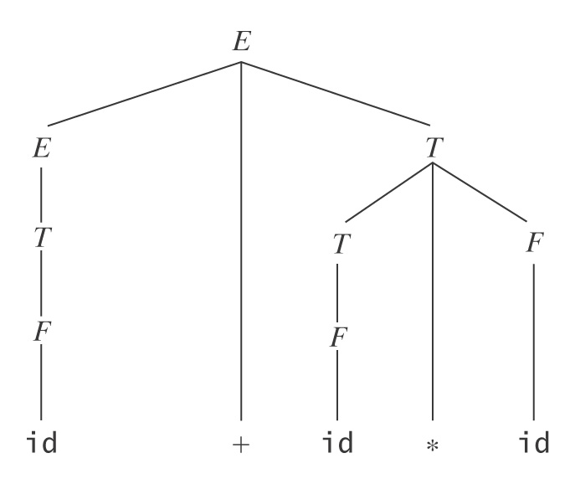
Arithmetic Expressions - A Better Way
E → E + T
E → T
T → T * F
T → F
F → (E)
F → id
Example:
id + id * id

Slide 46
Dangling “else”
The dangling else problem:
<stmt> ::= if <cond> then <stmt>
<stmt> ::= if <cond> then <stmt> else <stmt>
Consider:
if cond₁ then if cond₂ then stmt₁ else stmt₂

Slide 47
Dangling “else” ambiguity
<stmt>
if <cond> then <stmt> else <stmt>
<stmt>
cond₁
stmt₂
if <cond> then <stmt>
if <cond> then <stmt>
cond₁
cond₂
stmt₁
if <cond> then <stmt> else <stmt>
cond₂
stmt₁
stmt₂

Slide 48
Dangling “else” solution
<stmt> ::= <matched_if>
| <unmatched_if>
<matched_if> ::= if <cond> then <matched_if> else <matched_if>
| <other_stmt>
<unmatched_if> ::= if <cond> then <stmt>
| if <cond> then <matched_if> else <unmatched_if>

Slide 49
Dangling “else” solution
<stmt>
<unmatched_if>
if <cond> then <stmt>
cond₁
<matched_if>
if <cond> then <matched_if> else <matched_if>
cond₂
other_stmt
other_stmt
stmt₁
stmt₂

